Slide 1
CREATE TIME ATTRIBUTE VIEW.
Milind Parab

Slide 2
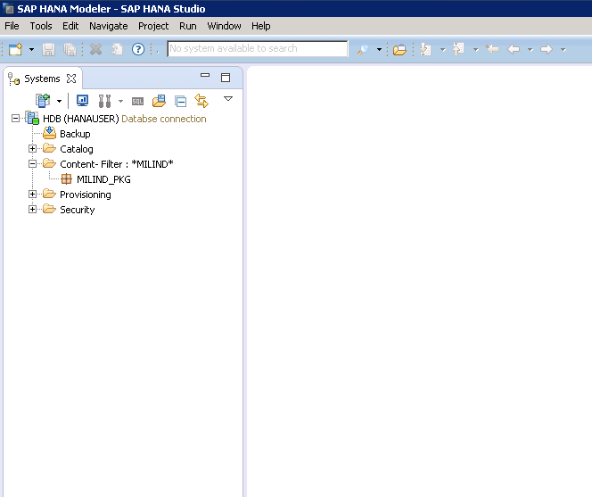
Create a Package.

Slide 3
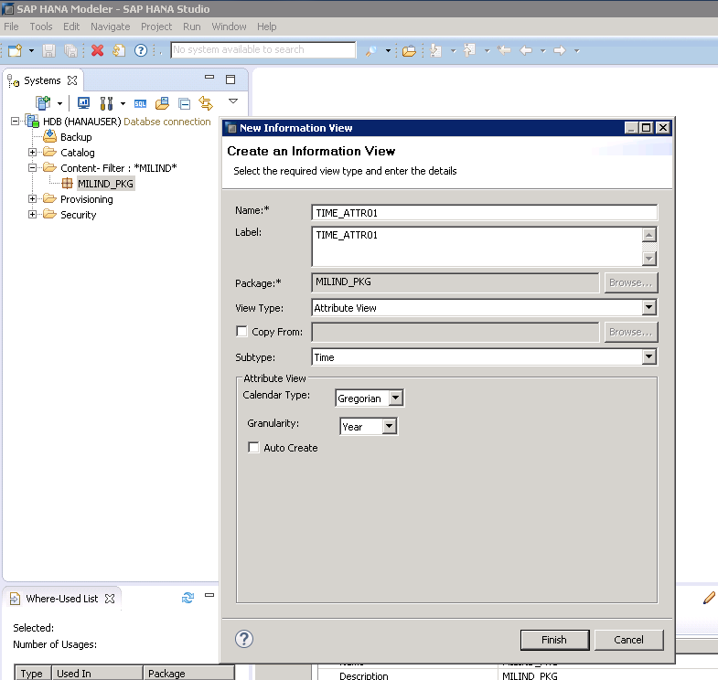
Create Time Attr. View.

Slide 4
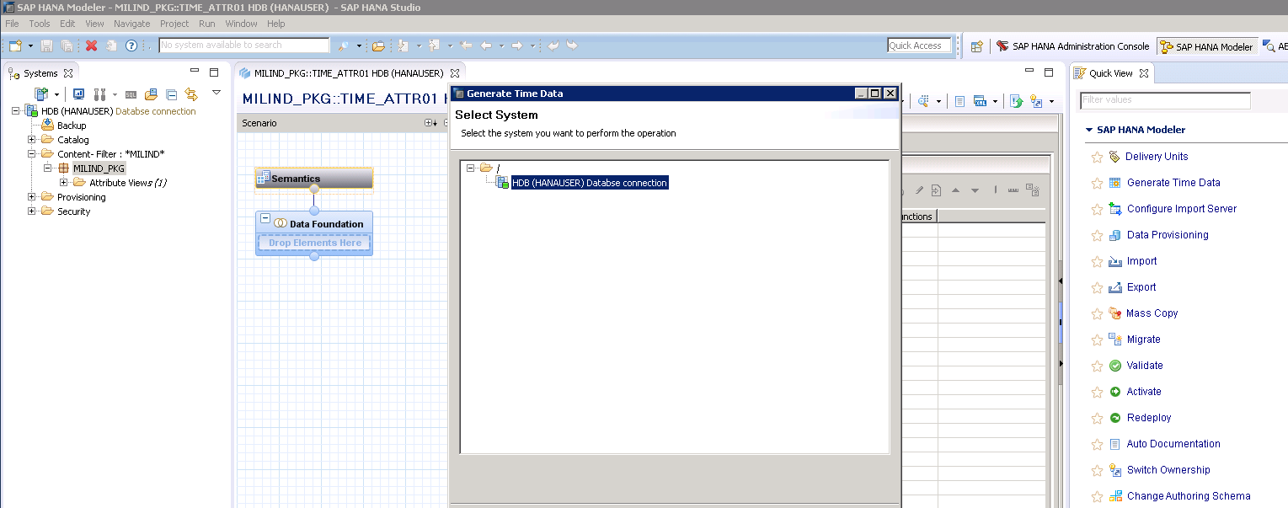
Click on generate Time View.

Slide 5
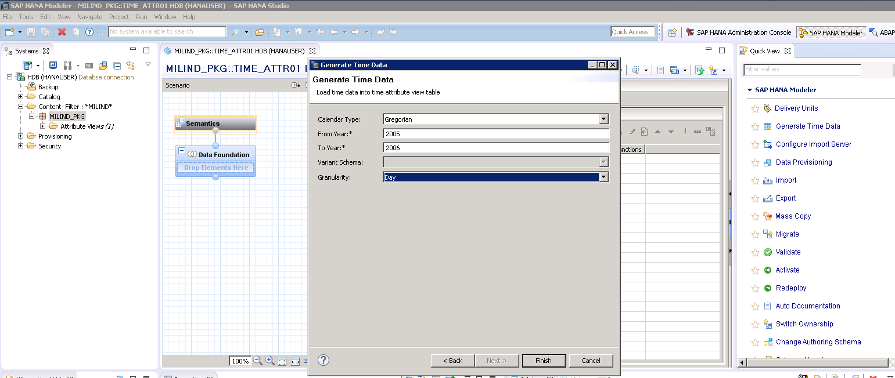
Click on finish.

Slide 6
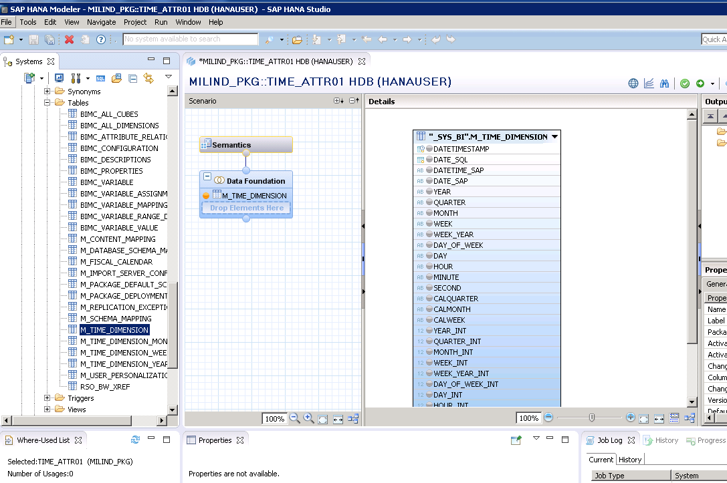
Get “M_TIME_DIMENTION” from SYS_BI table.

Slide 7
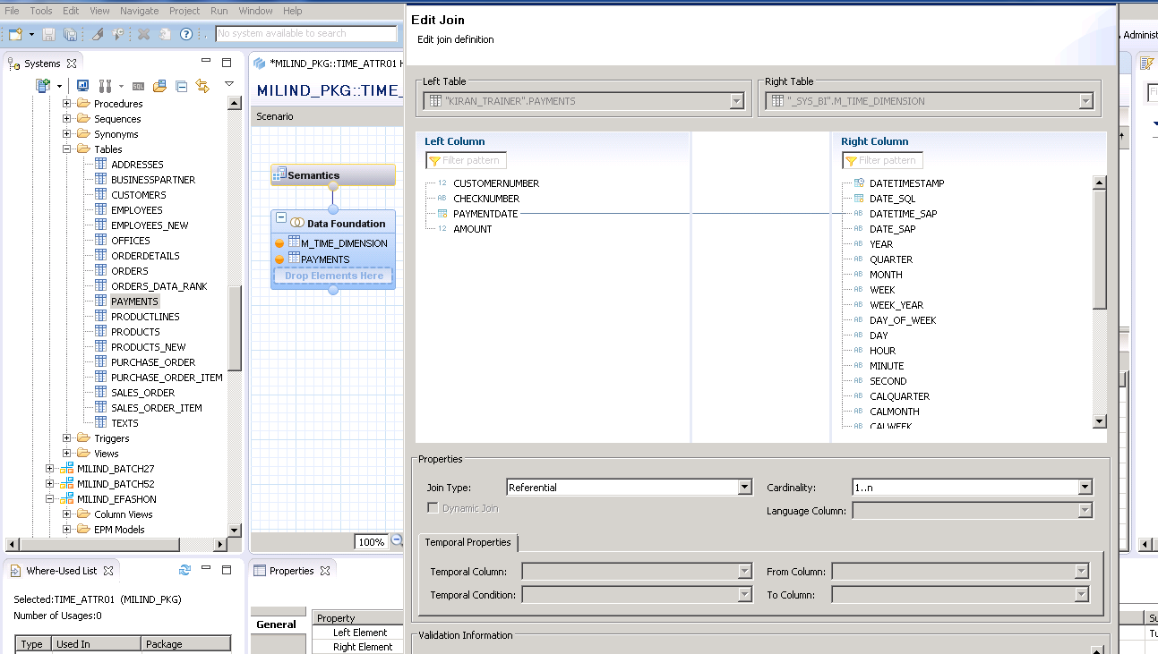
Create Join.

Slide 8
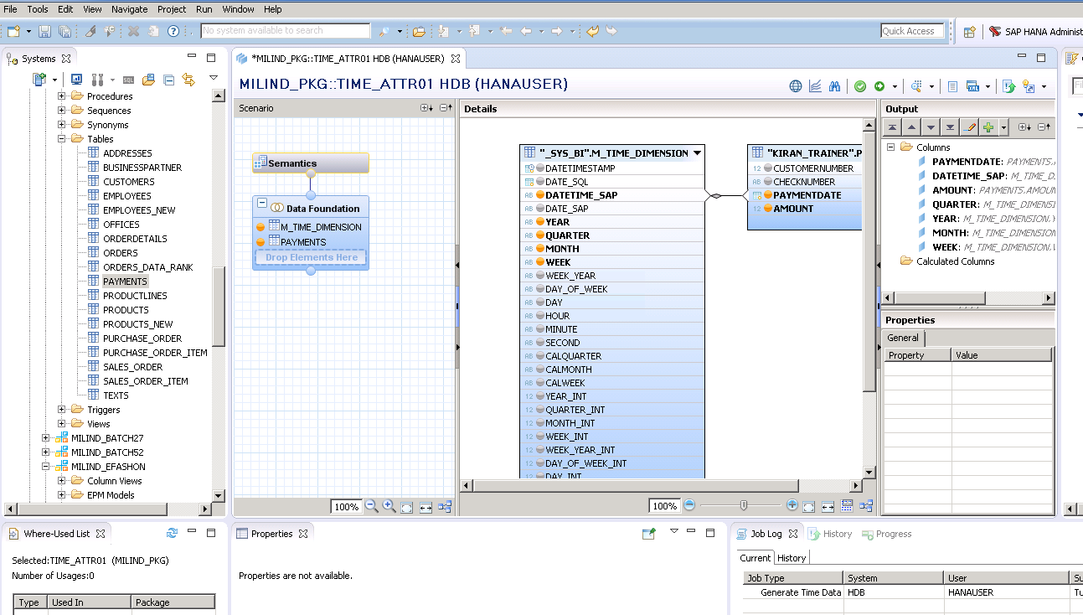
Cont.

Slide 9
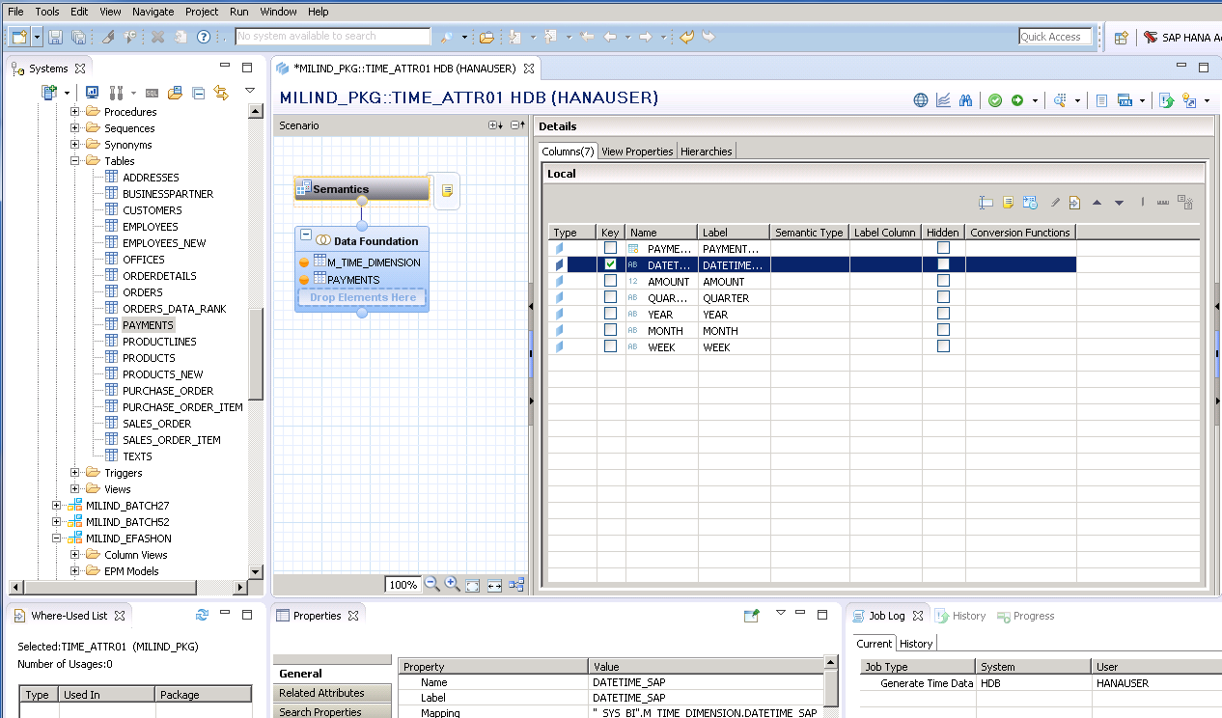
Cont.

Slide 10
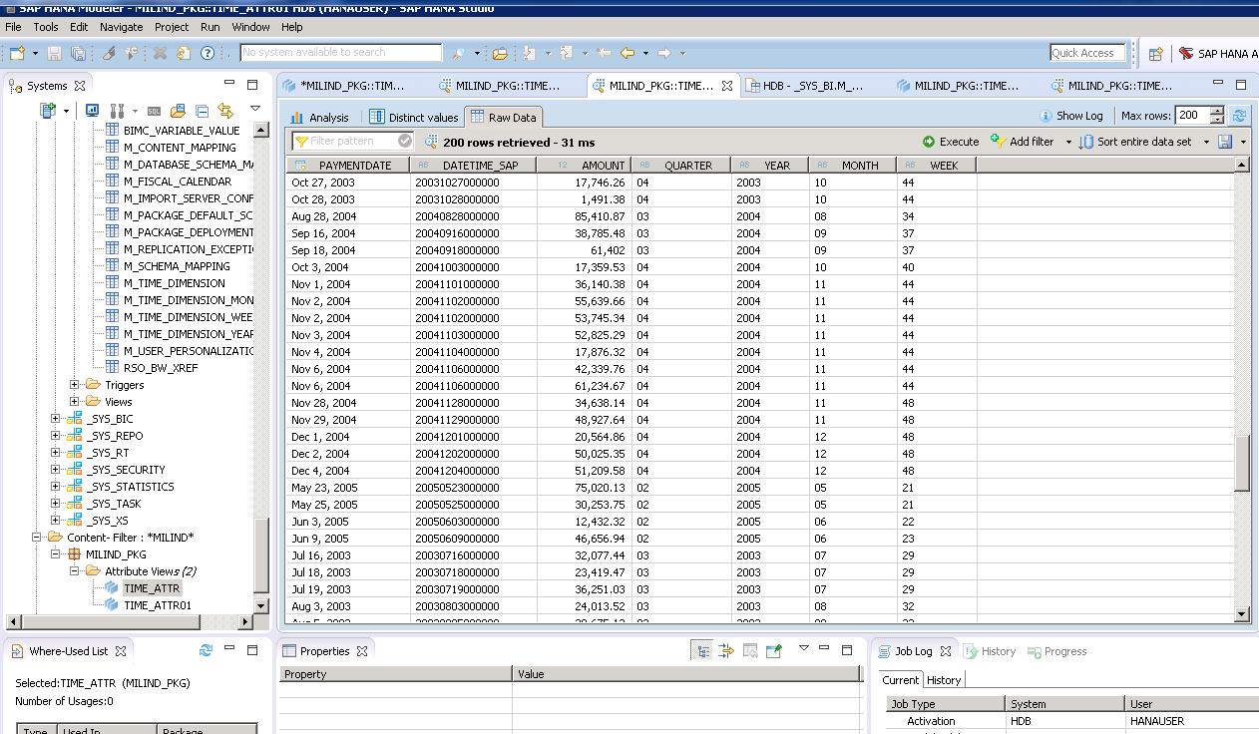
Go to semantic, select key attribute and activate.

